Slide 1
Algebraic graph algorithms (a little algebra goes a long way)
Jesper Nederlof
NETWORKS training week ‘19 Asperen

Slide 2
Polynomial Identity Testing

Slide 3
Polynomial Identity Testing (PIT)
Given: polynomial $p(x1, x2, …, xn)$ as arithmetic circuit (fan-out 1):
Question: Is $p$ identically zero?
i.e., is $p(x) = 0$for all $x∈𝔽n$
(assume $𝔽$ larger than degree…)
*
-
*
*
+
-
x₁
x₂
x₃
…
x_{n}

Slide 4
Polynomial Identity Testing (PIT)
try all $𝔽^{n}$ inputs?
may be exponentially many
multiply out symbolically, check that all coefficients are zero?
may be exponentially many coefficients
can randomness help?
i.e., flip coins, allow small probability of wrong answer

Slide 5
Polynomial Identity Testing (PIT)
Lem (Lipton-Demillo-Schwartz-Zippel) Let $p(x1, x2, …, xn)$ be a total degree $d$ polynomial over $𝔽$ and $S⊆𝔽$. If $p$ is non-zero, and $r_{1},…r_{n}∈_{R}S$
$Pr\left[p\left(r_{1},…, r_{n}\right)=0\right]≤\frac{d}{|S|}$
(Note: this probability bound does not depend on n.)

Slide 6
Polynomial Identity Testing (PIT)
Proof:
induction on number of variables n
base case: $n = 1$, $p$ is univariate polynomial of degree at most $d$
at most $d$ roots, so
$Pr⁡[ p(r1)=0] ≤ d/|S$|

Slide 7
Polynomial Identity Testing (PIT)
write $p(x1, x2, …, xn)$ as
$$p\left(x1, x2, …, xn\right)= \sum_{i=0}^{d}{x_{1}^{i}}⋅p_{i}(x2, …, xn)$$
Let $k = max⁡i$for which $pi(x2, …, xn)$is not identically zero,
So $pk(x2, …, xn)$ has degree $d−k$
By induction hypothesis:
$$Pr⁡[pk(r2, …, rn) = 0] ≤ (d−k)/|S|$$
Whenever $pk(r2, …, rn) ≠ 0$, $p(x1, r2, …, rn)$ is a univariate polynomial of degree $k$, so by induction hypothesis:
$$Pr⁡[p(r1,r2,…,rn)=0 | pk(r2,…,rn) ≠ 0] ≤ k/|S|$$

Slide 8
Polynomial Identity Testing (PIT)
So we have shown both:
(1) $Pr⁡[ pk(r2, …, rn) = 0] ≤ (d−k)/|S|$
(2) $Pr⁡[p(r1,r2,…,rn)=0 | pk(r2,…,rn)≠0]≤ k/|S|$
We conclude:
$$Pr⁡[ p(r1, …, rn) = 0] ≤ (d−k)/|S| + k/|S| = d/|S|$$
Note: can add these probabilities (1) + (2) because:
$$Pr⁡[E2] = Pr⁡[E2|E1]Pr⁡[E1] + Pr⁡[E2|➢E1]Pr⁡[➢ E1]$$
$$≤ \operatorname{Pr}\left[E1\right] +\operatorname{Pr}\left[E2 | ➢E1\right]$$

Slide 9
Polynomial Identity Testing (PIT)
Given: polynomial $p(x1, x2, …, xn)$
Is $p$ identically zero?
Note: degree $d$ is at most the size of input
*
-
*
*
+
-
x₁
x₂
x₃
…
x_{n}

Slide 10
Polynomial Identity Testing (PIT)
Randomized algorithm:
given field $𝔽$, pick a subset $S⊆𝔽$of size $2d$
pick $r1, r2, …, rn$from $S$ uniformly at random
if $p(r1, r2, …, rn) = 0$, answer “yes”
if $p(r1, r2, …, rn) ≠ 0$, answer “no”
if $p$ identically zero, never wrong
if not, ensures probability of error at most ½

Slide 11
Matchings (‘The assignment problem’)

Slide 12
Bipartite Perfect Matching
L
R
Let $G=(L∪R,E)$ be a bipartite graph Does $G$ have a perfect matching?
$L:=\{r_{1},…,r_{n}\}$, $B:=\{r_{1},…,r_{n}\}$
$M\left[i,j\right]:=\left\{\begin{aligned}0, \text{if} \{l_{i},r_{j}\}∉E \\ &1, \text{if} \{l_{i},l_{j}\}∈E\end{aligned}\right.$
1
1
2
2
3
3
4
4
$${\left(−1\right)}^{inv(π)}$$
$$\det\left(M\right)≔ \sum_{π:\left[n\right]↔[n]}{sgn\left(π\right)\prod_{i}{M[i,j]} }$$
 | 1 | 2 | 3 | 4
1 | $$1$$ | $$1$$ | 0 | 0
2 | 0 | $$1$$ | 0 | 0
3 | 0 | $$1$$ | 0 | $$1$$
4 | 0 | 0 | $$1$$ | $$1$$
$$\operatorname{per}\left(M\right)≔ \sum_{π:\left[n\right]↔[n]}{sgn\left(π\right)\prod_{i}{M[i,j]} }$$

Slide 13
Bipartite Perfect Matching
L
R
Let $G=(L∪R,E)$ be a bipartite graph. Does $G$ have a perfect matching?
$L:=\{r_{1},…,r_{n}\}$, $B:=\{r_{1},…,r_{n}\}$
$M\left[i,j\right]:=\left\{\begin{aligned}0, \text{if} \{l_{i},r_{j}\}∉E \\ &x_{ij}, \text{if} \{l_{i},l_{j}\}∈E\end{aligned}\right.$
1
1
2
2
3
3
4
4
$${\left(−1\right)}^{inv(π)}$$
$$\det\left(M\right)≔ \sum_{π:\left[n\right]↔[n]}{sgn\left(π\right)\prod_{i}{M[i,j]} }$$
 | 1 | 2 | 3 | 4
1 | $$x_{11}$$ | $$x_{12}$$ | 0 | 0
2 | 0 | $$x_{22}$$ | 0 | 0
3 | 0 | $$x_{32}$$ | 0 | $$x_{43}$$
4 | 0 | 0 | $$x_{43}$$ | $$x_{44}$$
$\det{(M)}$ is polynomial of degree $≤n$
Equal to zero-poly iff $G$ has no PM ($∀𝔽)$
PIT: randomized $n^{ω}$ algorithm

Slide 14
Non-Bipartite Perfect Matching
Let $G=(\{1,…,n\},E)$ be a graph
1
6
$$M\left[i,j\right]:=\left\{\begin{aligned}0, \text{if} \{i,j\}∉E \\ &x_{ij}, \text{if} \{i,j\}∈E, i<j \\ &{−x}_{ji}, \text{if} \{i,j\}∈E, i>j\end{aligned}\right.$$
2
5
3
4
$$\det\left(M\right)= \sum_{π:\left[n\right]↔[n]}{sgn\left(π\right)\prod_{i}{M[i,j]} }$$
 | 1 | 2 | 3 | 4 | 5 | 6
1 | $$0$$ | $$x_{12}$$ | $$x_{13}$$ | $$0$$ | $$0$$ | $$0$$
2 | $$−x_{12}$$ | $$0$$ | $$x_{23}$$ | $$0$$ | $$0$$ | $$0$$
3 | $$−x_{13}$$ | $$−x_{23}$$ | $$0$$ | $$x_{34}$$ | $$0$$ | $$x_{36}$$
4 | $$0$$ | $$0$$ | $$−x_{34}$$ | $$0$$ | $$x_{45}$$ | $$x_{46}$$
5 | $$0$$ | $$0$$ | $$0$$ | $$−x_{45}$$ | $$0$$ | $$x_{56}$$
6 | $$0$$ | $$0$$ | $${−x}_{36}$$ | $$−x_{46}$$ | $$−x_{56}$$ | $$0$$
$π$ can be thought of as cycle cover

Slide 15
Non-Bipartite Perfect Matching
Let $G=(\{1,…,n\},E)$ be a graph
1
6
$$M\left[i,j\right]:=\left\{\begin{aligned}0, \text{if} \{i,j\}∉E \\ &x_{ij}, \text{if} \{i,j\}∈E, i<j \\ &{−x}_{ji}, \text{if} \{i,j\}∈E, i>j\end{aligned}\right.$$
2
5
3
4
$$\det\left(M\right)= \sum_{π:\left[n\right]↔[n]}{sgn\left(π\right)\prod_{i}{M[i,j]} }$$
 | 1 | 2 | 3 | 4 | 5 | 6
1 | $$0$$ | $$x_{12}$$ | $$x_{13}$$ | $$0$$ | $$0$$ | $$0$$
2 | $$−x_{12}$$ | $$0$$ | $$x_{23}$$ | $$0$$ | $$0$$ | $$0$$
3 | $$−x_{13}$$ | $$−x_{23}$$ | $$0$$ | $$x_{34}$$ | $$0$$ | $$x_{36}$$
4 | $$0$$ | $$0$$ | $$−x_{34}$$ | $$0$$ | $$x_{45}$$ | $$x_{46}$$
5 | $$0$$ | $$0$$ | $$0$$ | $$−x_{45}$$ | $$0$$ | $$x_{56}$$
6 | $$0$$ | $$0$$ | $${−x}_{36}$$ | $$−x_{46}$$ | $$−x_{56}$$ | $$0$$
$π$ can be thought of as cycle cover
$sgn\left(π\right)$ can be thought of as $−1^{\#even cyc^{′}s}$
cyc covers with odd cycle cancel!
$\det\left(M\right)≡0$ iff $G$ has a PM
Use PIT -> $n^{ω}$ randomized algo

Slide 16
…
Note: If $A$ is doubly-stochastic, nothing happens

Slide 17
Suppose condition on Line 4 holds, yet $G$ has no PM
Kőnig theorem implies: $G$ has vertex cover $X=X_{L}∪X_{R}$ with $\left|X\right|≤n−1$
Since $X$ is a $VC$,
L
R
1
1
2
2
$$n≤\sum_{\begin{aligned}i∈X \\ j∈N(i)\end{aligned}}{\sum_{j∈N\left(i\right)}{a_{ij}}}=\sum_{\begin{aligned}i∈X_{L} \\ j∈N(i)\end{aligned}}{a_{ij}}+\sum_{\begin{aligned}j∈X_{R} \\ i∈N(j)\end{aligned}}{a_{ij}}$$
3
3
4
4
$$≤\left|X_{L}\right|\left(1+1/n\right)+|X_{r}|$$
$$≤\left(n−1\right)\left(1+1/n\right)=n−1/n$$

Slide 18
Suppose $H$ has a PM
After first row-normalization
$$per\left(A\right)=\sum_{π:\left[n\right]↔[n]}{\prod_{i=1}^{n}{A[i,π(i)]}}≥1/n^{n}$$
2. If $B$ is obtained from row (or column) normalizing $A$ then
$$\text{per}\left(B\right)≥\frac{\text{per}\left(A\right)}{\prod_{i}{r_{i}}} ≥\text{per}\left(A\right)⋅exp⁡(1/n^{2})$$
After the first step, $\text{per}\left(A\right)≤1$
[ ]

Slide 19
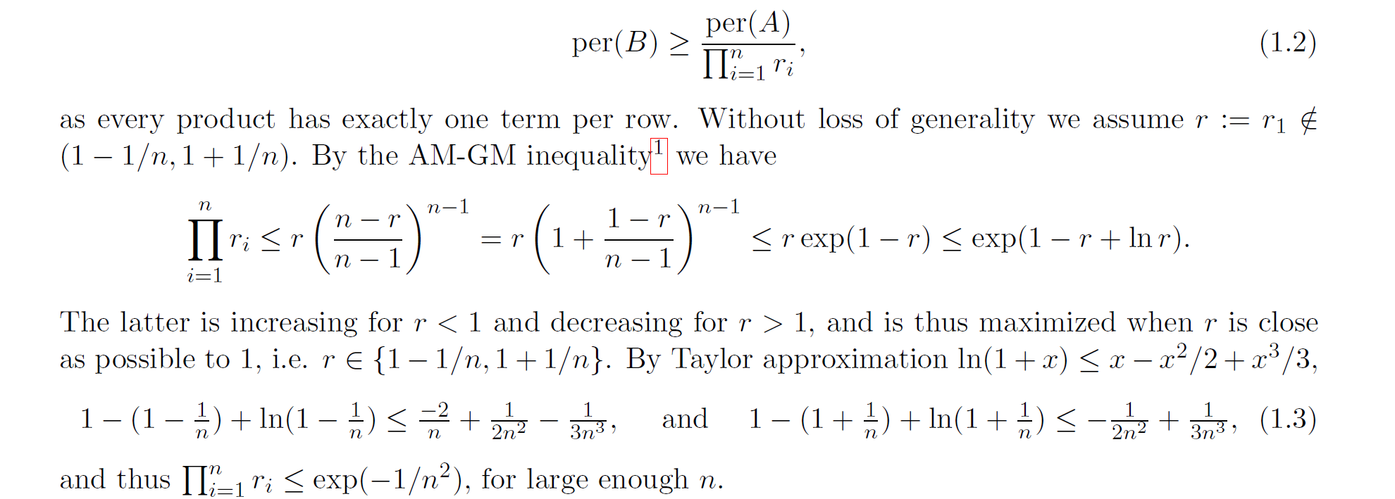
2-page lecture note available at Jesper’s homepage
Original reference: Nathan Linial, Alex Samorodnitsky, and Avi Wigderson. A deterministic strongly polynomial algorithm for matrix scaling and approximate permanents. Combinatorica, Apr 2000.

Slide 20
Perfect Matching in Parallel
Recall: Determinant is in NC
$O(\log^{c}{n })$ time using $O(n^{k})$ processors
Is constructing a matching also in NC?
The processors may try to construct different solutions!
We will solve this by applying some randomness first to ensure there is a single solution

Slide 21
$w(S)$ denotes $\sum_{e∈S}{w\left(e\right)}$
Definition (Isolation) Given a set family $ℱ⊆2^{U}$, and weight function $w:U→\{1,…,N\},$
we say $w$ isolates $ℱ$ if there is a unique minimizer $S∈ℱ$ of $w$, i.e. there is a unique $S∈ℱ$ s.t. $w\left(S\right)=\min_{S^{′}∈ℱ} w(S^{′})$.
Isolation Lemma
For every $e∈U$, choose $w\left(e\right)∈\{1,…,N\}$ uniformly at random. Then, if $ℱ$ is not empty:
$$\underset{w}{Pr}\left[w \text{isolates} ℱ\right]≥1−\frac{\left|U\right|}{N}$$

Slide 22
$ω(S)$ denotes $\sum_{e∈S}{ω\left(e\right)}$
Isolation Lemma
For every $e∈U$, choose $w\left(e\right)∈\{1,…,N\}$ uniformly at random. Then, if $ℱ$ is not empty:
Definition (Isolation) Given a set family $ℱ⊆2^{U}$, and weight function $ω:U→\{1,…,N\},$
we say $ω$ isolates $ℱ$ if there is a unique minimizer $S∈ℱ$ of $ω$, i.e. there is a unique $S∈ℱ$ s.t. $ω\left(S\right)=\min_{S^{′}∈ℱ} ω(S^{′})$.
$$\underset{w}{Pr}\left[w \text{isolates} ℱ\right]≥1−\frac{\left|U\right|}{N}$$
Proof:
Define $a\left(e\right)=\min_{e∉S∈ℱ}{w(S)}− \min_{e∈S∈ℱ}{w(S∖e})$
Notice $a(e)$ does not depend on $w\left(e\right)$ so they are independent
Thus for every $e∈U$ we have $\operatorname{Pr}\left[a\left(e\right)=w\left(e\right)\right]≤\frac{1}{N}$
Assume $S_{1},S_{2}∈ℱ$ are two distinct minimizers of $w$, $e∈S_{2}∖S_{1}$
But then $a\left(e\right)=\min_{e∉S∈ℱ}{w(S)}− \min_{e∈S∈ℱ}{w(S∖e})=w(e)$
So the event that $w$ does not isolate $ℱ$ implies $∃e:a\left(e\right)=w\left(e\right)$
$\operatorname{Pr}\left[w \text{does} \text{not} \text{isolate} ℱ\right]≤\operatorname{Pr}\left[∃e:a\left(e\right)=w\left(e\right) \right]$ which is at most $\sum_{e∈U}{Pr⁡[}a\left(e\right)=w(e)]$ by the union bound, which is $≤|U|/N$
$\min_{e∉S∈ℱ}{w(S)}=w\left(S_{1}\right)=w\left(S_{2}\right)=$ $\min_{e∈S∈ℱ}{w(S)}=\min_{e∈S∈ℱ}{w\left(S∖e\right)+w(e)}$
$$\operatorname{Pr}\left[A∪B\right]≤\operatorname{Pr}\left[A\right]+Pr⁡[B]$$

Slide 23
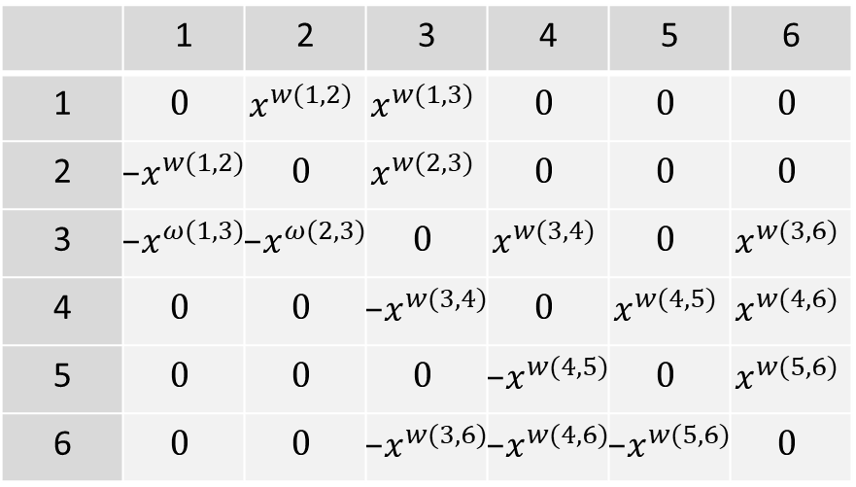
Matching in RNC (and now in quasi-NC)
Let $G=(\{1,…,n\},E)$ be a graph
Pick $w\left(i,j\right)∈_{R}\{1,…,2|E|\}$
If $G$ has PM, there exists $w$ such that $G$ has a unique PM of weight $w$
1
6
2
5
3
4
$$M\left[i,j\right]:=\left\{\begin{aligned}0, \text{if} \{i,j\}∉E \\ &x^{w(i,j)}, \text{if} \{i,j\}∈E, i<j \\ &x^{−w(i,j)}, \text{if} \{i,j\}∈E, i>j\end{aligned}\right.$$
$$\det\left(M\right)≈\sum_{M PM of G}{x^{w(M)} }$$
Use interpolation, or evaluate $x≔1/n^{n}$ to get min-weight

Slide 24
Triangles

Slide 25
Detecting/Counting Triangles
Trivially in $O(n^{3})$ time. Can we do faster?
Let $G=(V,E)$ be undirected; $V=\{v_{1},…,v_{n}\}$
$A$ is adjacency matrix i.e. $a_{ij}=1$ iff $\{v_{i},v_{j}\} ∈E$
If $B:=A^{2}$
$b_{ij}=\sum_{k=1}^{n}{a_{ik}a_{kj}}=$ #walks from $v_{i}$ to $v_{j}$ on two edges
If $C:=A^{3},$
$c_{ij}= \sum_{k,l=1}^{n}{a_{ik}a_{kl}a_{lj}}=\#$walks from $v_{i}$ to $v_{j}$ on three edges
$c_{ii}=$ 2*#triangles containing $i$
$trace\left(C\right):=\sum_{i=1}^{n}{c_{ii}=}$ #triangles*6 (3 startpoints, 2 directions)
$O(n^{ω})$ time algo

Slide 26
Finding a Maximum Weight Triangle
$G=(V,E)$ undirected; $V=\{v_{1},…,v_{n}\}$, $w:E→\{1,…,W\}$
Define $A$ as follows: $a_{ij}:=n^{3w(\{v_{i},v_{j}\})}$ ($w\left(e\right)=−∞ if e∉E$)
$C:=A^{3};$ $c_{ii}$ equals
$$\sum_{k,l=1}^{n}{a_{ik}a_{kl}a_{li} }=\sum_{triangle (v_{i},v_{k},v_{l}) }{n^{3w(\left\{v_{i},v_{k}\right\},\left\{v_{i},v_{l}\right\},\{v_{k},v_{l}\})}}$$
If there is a triangle containing $v_{i}$ of weight $≥x$, $c_{ii}≥n^{3x}$
If there is no triangle containing $v_{i}$ of weight $≥x$, $c_{ii}<n^{3x}$:
All $n^{2}$ triples containing $i$ are weight $≤(x−1)$ triangles.
Thus $c_{ii}≤n^{2}n^{3(x−1)}=n^{3x−1}<n^{3x}$
Nice, but runtime is $n^{ω}W$…..

Slide 27
The Weak Spot of Algebraic Algorithms
What if subtraction is not available?
Consider matrix mult over min-sum semi-ring:
$$B∗_{ms}C=\min_{k} B\left[i,k\right]⋅C[k,j]$$
Open: Can it be solved in $n^{2.999}\log{W}$ time?!
Equivalent to All Pairs Shortest Pairs (APSP)
Given edge length matrix $L$, compute all shortest path lengths
Equal to $L∗_{ms}L ∗_{ms}L⋯$ ($n$ times)
Turns out to be equivalent to complexity of max weight triangle problem

Slide 28
Vertex-Weighted Triangle
Based on work by Vassilevska-Williams& Williams, Chandra et al. (see notes)
Surprise: Can do better if vertices are weighted
$G=(V,E)$ undirected; $V=\{v_{1},…,v_{n}\}$, $w:V→\{1,…,W\}$
Can detect triangle of weight exactly (or at least) $t$ in time $O(n^{ω}2^{\sqrt{\log{W}}})$
Even interesting if $G$ has no edges!
(the $3$-SUM problem)
Can assume $W≤n^{3}$ using randomization (work mod $p≈n^{3}$)
Focus on exact case (at least case follows by rounding tricks)
Notes:
Virginia Vassilevska Williams, Ryan Williams:
Finding, Minimizing, and Counting Weighted Subgraphs. SIAM J. Comput. 42(3): 831-854 (2013)

Slide 29
Vertex-Weighted Triangle
Based on work by Vassilevska-Williams& Williams, Chandra et al. (see notes)
Surprise: Can do better if vertices are weighted
$G=(V,E)$ undirected; $V=\{v_{1},…,v_{n}\}$, $w:V→\{1,…,W\}$
Can detect triangle of weight exactly (or at least) $t$ in time $O(n^{ω}2^{\sqrt{\log{W}}})$
We focus at the exact case
Assume the graph is tripartite
Use a communication game
C
$$t=9$$
2
4
5
1
4
3
3
A
B
3
2
Notes:
Virginia Vassilevska Williams, Ryan Williams:
Finding, Minimizing, and Counting Weighted Subgraphs. SIAM J. Comput. 42(3): 831-854 (2013)
Ashok K. Chandra, Merrick L. Furst, Richard J. Lipton:
Multi-Party Protocols. STOC 1983: 94-99

Slide 30
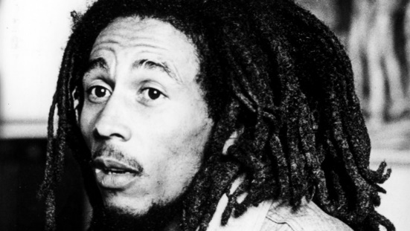
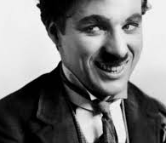
Exact Integer Sum NOF
Based on work by Vassilevska-Williams& Williams, Chandra et al. (see notes)
a
Alice Bob and Charlie
have $n$-bit ints a,b,c on their forehead
Alice only sees $b,c$, …
Write on a blackboard
Goal determine whether $a+b+c=0$, by writing few fits
Trivial solution: $3n$ bits
We’ll see now: $O(\sqrt{n})$ bits
Step 1: Reduce to case $a,b,c∈{\{1,…,2^{O\left(\sqrt{n}\right)}\}}^{O(\sqrt{n})}$
Step 2: Solve modified case using $O(\sqrt{n})$ bits
c
b
Notes:
Virginia Vassilevska Williams, Ryan Williams:
Finding, Minimizing, and Counting Weighted Subgraphs. SIAM J. Comput. 42(3): 831-854 (2013)
Ashok K. Chandra, Merrick L. Furst, Richard J. Lipton:
Multi-Party Protocols. STOC 1983: 94-99

Slide 31
Exact Integer Sum NOF
Based on work by Vassilevska-Williams& Williams, Chandra et al. (see notes)
a
Alice Bob and Charlie
have $n$-bit ints a,b,c on their forehead
Alice only sees $b,c$, …
Write on a blackboard
Goal determine whether $a+b+c=0$, by writing few fits
c
b
$$a_{l}$$
$$a_{l−1}$$
$$a_{1}$$
$$a_{0}$$
$a= \sum_{i=0}^{l}{a_{i}{10}^{ni/l}}$
$b= \sum_{i=0}^{l}{b_{i}{10}^{ni/l}}$
$c= \sum_{i=0}^{l}{c_{i}{10}^{ni/l}}$
A,B, and C can compute carry ${\{1,…, 30\}}^{l}$ if their missing integer is correct verify if they coincide in $O(l)$ bits.
$$a =407948609486094869$$
$$b =946509485923958233$$
$$c =946509485923958233$$
Notes:
Virginia Vassilevska Williams, Ryan Williams:
Finding, Minimizing, and Counting Weighted Subgraphs. SIAM J. Comput. 42(3): 831-854 (2013)
Ashok K. Chandra, Merrick L. Furst, Richard J. Lipton:
Multi-Party Protocols. STOC 1983: 94-99

Slide 32
Exact Integer Sum NOF
Based on work by Vassilevska-Williams& Williams, Chandra et al. (see notes)
a
Alice Bob and Charlie
have $n$-bit ints a,b,c on their forehead
Alice only sees $b,c$, …
Write on a blackboard
Goal determine whether $a+b+c=0$, by writing few fits
Step 2: $a,b,c∈\{2^{O\left(\sqrt{n}\right)}\}^{\sqrt{n}}$
c
b
$$∀i: a_{i}=b_{i}=c_{i}=0↔\sum_{i=1}^{\sqrt{n}}{{\left(a_{i}+b_{i}+c_{i}\right)}^{2}}=0$$
$$↔\sum_{i=1}^{\sqrt{n}}{a_{i}^{2}+b_{i}^{2}+c_{i}^{2}+a_{i}b_{i}}+a_{i}c_{i}+b_{i}c_{i}=0$$
Notes:
Virginia Vassilevska Williams, Ryan Williams:
Finding, Minimizing, and Counting Weighted Subgraphs. SIAM J. Comput. 42(3): 831-854 (2013)
Ashok K. Chandra, Merrick L. Furst, Richard J. Lipton:
Multi-Party Protocols. STOC 1983: 94-99

Slide 33
Vertex-Weighted Triangle
Based on work by Vassilevska-Williams& Williams, Chandra et al. (see notes)
Surprise: Can do better if vertices are weighted
$G=(V,E)$ undirected; $V=\{v_{1},…,v_{n}\}$, $ω:V→\{1,…,W\}$
Can detect triangle of weight exactly (or at least $t$) in time $O(n^{ω}2^{\sqrt{\log{W}}})$
We focus at the exact case
Assume the graph is tripartite
Try all transcripts with YES result
Keep edge between BC, AC, AB if
consistent with transcript
C
$$t=9$$
2
4
5
1
4
3
3
A
B
3
2
Notes:
Virginia Vassilevska Williams, Ryan Williams:
Finding, Minimizing, and Counting Weighted Subgraphs. SIAM J. Comput. 42(3): 831-854 (2013)
Ashok K. Chandra, Merrick L. Furst, Richard J. Lipton:
Multi-Party Protocols. STOC 1983: 94-99

Slide 34
APSP in unweighted graphs
Given undirected $G=(V,E)$, $V=\{v_{1},…,v_{n}\}$.
Want to compute $D$ with $d_{ij}$ distance (#edges on shortest path) from $v_{i}$ to $v_{j}$ in $n^{ω}$ time
Let $G^{′}=(V,E′)$ with ${(v}_{i},v_{j})$ iff $d_{ij}≤2$
Let $A,A′$ be adj matrices of $G$ and $G′$
If $C=A^{2}$, $a_{ij}^{′}=1$ iff $a_{ij}=1$ or $c_{ij}>0$. Thus $A^{′}$ in $O(n^{ω})$ time
The diameter of $G$ is length of the longest shortest path
If $diam\left(G\right)≤2$; $D=2A^{′}−A$;
D’ distance matrix for $A′$, $d_{ij}^{′}=⌈d_{ij}/2⌉$
$diam\left(G^{′}\right)≤⌈diam\left(G\right)/2⌉$
Idea: use recursion to shrink diameter quickly.
Need to compute $D$ from $D^{′}.$
has diameter 3

Slide 35
APSP in unweighted graphs
Given undirected $G=(V,E)$, $V=\{v_{1},…,v_{n}\}$.
Want to compute $D$ with $d_{ij}$ distance (#edges on shortest path) from $v_{i}$ to $v_{j}$ in $n^{ω}$ time
Let $G^{′}=(V,E′)$ with ${(v}_{i},v_{j})$ iff $d_{ij}≤2$
Let $A,A′$ be adj matrices of $G$ and $G′$
If $C=A^{2}$, $a_{ij}^{′}=1$ iff $a_{ij}=1$ or $c_{ij}>0$. Thus $A^{′}$ in $O(n^{ω})$ time
The diameter of $G$ is length of the longest shortest path
If $diam\left(G\right)≤2$; $D=2A^{′}−A$;
D’ distance matrix for $A′$, $d_{ij}^{′}=⌈d_{ij}/2⌉$
$diam\left(G^{′}\right)≤⌈diam\left(G\right)/2⌉$
Idea: use recursion to shrink diameter quickly.
Need to compute $D$ from $D^{′}.$
i
j
i
j

Slide 36
APSP in unweighted graphs
Given undirected $G=(V,E)$, $V=\{v_{1},…,v_{n}\}$.
Want to compute $D$ with $d_{ij}$ distance (#edges on shortest path) from $v_{i}$ to $v_{j}$ in $n^{ω}$ time
Let $G^{′}=(V,E′)$ with ${(v}_{i},v_{j})$ iff $d_{ij}≤2$
Let $A,A′$ be adj matrices of $G$ and $G′$
If $C=A^{2}$, $a_{ij}^{′}=1$ iff $a_{ij}=1$ or $c_{ij}>0$. Thus $A^{′}$ in $O(n^{ω})$ time
The diameter of $G$ is length of the longest shortest path
If $diam\left(G\right)≤2$; $D=2A^{′}−A$;
D’ distance matrix for $A′$, $d_{ij}^{′}=⌈d_{ij}/2⌉$
$diam\left(G^{′}\right)≤⌈diam\left(G\right)/2⌉$
Idea: use recursion to shrink diameter quickly
Need to compute $D$ from $D^{′}$

Slide 37
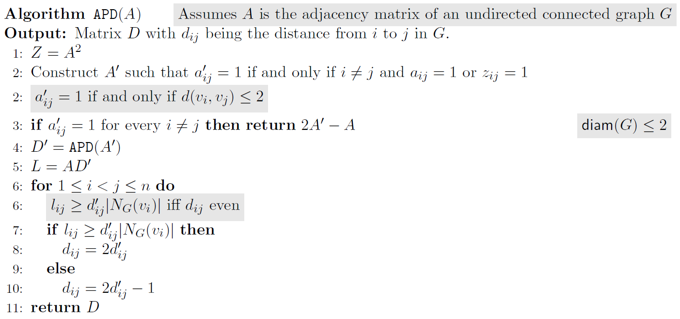
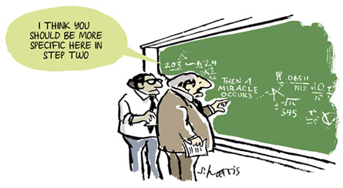
Compute $D$ from $D′$
in $O(n^{ω})$ time
$T\left(n,diam\right)≤2n^{ω}+T\left(n,\left\lceil diam/2\right\rceil \right)+O(n^{2})$
$T\left(n,diam\right)≤O(n^{ω}\log{n})$

Slide 38
Compute $D$ from $D′$
in $O(n^{ω})$ time
We already noticed $d_{ij}^{′}=⌈d_{ij}/2⌉$, or equivalently
So we only need to know the parity of $d_{ij}$!

Slide 39
Compute $D$ from $D′$
in $O(n^{ω})$ time
So we need the parity of $d_{ij}$ for all $i,j$
$d_{ij}−1≤d_{kj}≤d_{ij}+1$ for every $v_{k}∈N_{G}\left(v_{i}\right)$
Claim: $d_{ij}$ is even iff $\sum_{k∈N_{G}(v_{i})}{d_{kj}^{′}}≥d_{ij}^{′}|N_{G}(v_{i})|$
If $d_{ij}$ even, $∀k: d_{kj}^{′}≥d_{ij}^{′}$ since $d_{kj}^{}≥d_{ij}−1$
If $d_{ij}$ odd, $∀k: d_{kj}^{′}≤d_{ij}^{′}$ since $d_{kj}^{}≤d_{ij}+1$; moreover $d_{kj}<d_{ij}$ for some $k$, and $d_{kj}^{′}<d_{ij}^{′}$

Slide 40
Compute $D$ from $D′$
in $O(n^{ω})$ time
So we need the parity of $d_{ij}$ for all $i,j$
$d_{ij}−1≤d_{kj}≤d_{ij}+1$ for every $v_{k}∈N_{G}\left(v_{i}\right)$
Claim: $d_{ij}$ is even iff $\sum_{k∈N_{G}(v_{i})}{d_{kj}^{′}}≥d_{ij}^{′}|N_{G}(v_{i})|$
We can compute $d_{ij}^{′}|N_{G}(v_{i})|$ in $O\left(n^{2}log n\right)$ time given $D^{′}$
Need to compute $l_{ij}=\sum_{k∈N_{G}(v_{i})}{d_{kj}^{′}}$
$L=AD′$, so can use matrix mult again!

Slide 41
Boolean Matrix Product and Witnesses
If $A,B∈\{0,1\}^{n×n}$, $A⊙B$ := $C$ with $c_{ij}=\bigvee_{k}{(a_{ik}∧b_{kj})}$
Can be computed from $C^{′}=AB$ since $c_{ij}=1$ iff $c_{ij}>0$
We would also like to have a witness ready for every $c_{ij}>0$, i.e. an integer $k$ such that $a_{ik}∧b_{kj}$
The witness matrix for $A⊙B=C$ is the matrix $W$ such that $w_{ij}=0$ if $c_{ij}=0$ and $w_{ij}$ is a witness for $ij$ otherwise
1
1
1
1 |  | 1
 |  | 1
 |  | 1 |  | 1
 | 1
 |  |  | 1
1 | 1
 |  | 1
 | 1
 |  |  | 1
 |  |  | 1 | 1
1 | 1
 | 1
 | 1 |  | 1 | 1
 |  | 1
 |  |  | 1
2
2
2
3
3
3
4
4
4
5
5
5
$$A$$
$$B$$
$$A$$
$$B$$
$$A⊙B$$

Slide 42
Boolean Matrix Product and Witnesses
If $A,B∈\{0,1\}^{n×n}$, $A⊙B$ := $C$ with $c_{ij}=\bigvee_{k}{(a_{ik}∧b_{kj})}$
Can be computed from $C^{′}=AB$ since $c_{ij}=1$ iff $c_{ij}>0$
We would also like to have a witness ready for every $c_{ij}>0$, i.e. an integer $k$ such that $a_{ik}∧b_{kj}$
The witness matrix for $A⊙B=C$ is the matrix $W$ such that $w_{ij}=0$ if $c_{ij}=0$ and $w_{ij}$ is a witness for $ij$ otherwise
Obs: if unique witness exists, can use$\hat{A}B$ where ${\hat{a}}_{ij}=ja_{ij}$
1
1
1
1 |  | 1
 |  | 1
 |  | 1 |  | 1
 | 1
 |  |  | 1
1 | 1
 |  | 1
 | 1
 |  |  | 1
 |  |  | 1 | 1
1 | 1
 | 1 | 1
 | 1 | 1 | 1 | 1
 |  | 1
 |  |  | 1
1 | 1
 | 3
 | 3 |  | 5 | 5
 |  | 2
 |  |  | 4
2
2
2
3
3
3
4
4
4
5
5
5
$$A$$
$$B$$
$$A$$
$$B$$
Witness Matrix for $A⊙B$

Slide 43
Boolean Matrix Product and Witnesses
If $A,B∈\{0,1\}^{n×n}$, $A⊙B$ := $C$ with $c_{ij}=\bigvee_{k}{(a_{ik}∧b_{kj})}$
Can be computed from $C^{′}=AB$ since $c_{ij}=1$ iff $c_{ij}>0$
We would also like to have a witness ready for every $c_{ij}>0$, i.e. an integer $k$ such that $a_{ik}∧b_{kj}$
The witness matrix for $A⊙B=C$ is the matrix $W$ such that $w_{ij}=0$ if $c_{ij}=0$ and $w_{ij}$ is a witness for $ij$ otherwise
Obs: if unique witness exists, can use$\hat{A}B$ where ${\hat{a}}_{ij}=ja_{ij}$
1
1
1
1 |  | 3
 |  | 3
 |  | 3 |  | 5
 | 2
 |  |  | 4
1 | 1
 |  | 1
 | 1
 |  |  | 1
 |  |  | 1 | 1
1 | 1
 | 3
 | 3 |  | 5 | 5
 |  | 2
 |  |  | 4
1 | 4
 | 3
 | 3 |  | 5 | 5
 |  | 2
 |  |  | 4
1 | 1
 | 1
 | 1 |  | 1 | 1
 |  | 1
 |  |  | 1
2
2
2
3
3
3
=
4
4
4
5
5
5
$$A$$
$$B$$
$$\hat{A}$$
$$B$$
Witness Matrix for $A⊙B$

Slide 44
Successor Matrix
Given undirected graph $G$, the successor matrix $S$ is such that $s_{ij}$ is the successor of $v_{i}$ on the shortest path from $v_{i}$ to $v_{j}$.
Can also be computed in $n^{ω}$ time
Combination of APD matrix and Boolean matrix mult
- | 2 | 3 | 2 | 3
1 | - | 3 | 4 | 4
1 | 2 | - | 4 | 4
3 | 2 | 3 | - | 5
4 | 4 | 4 | 4 | -
3
4
1
2
5

Slide 45
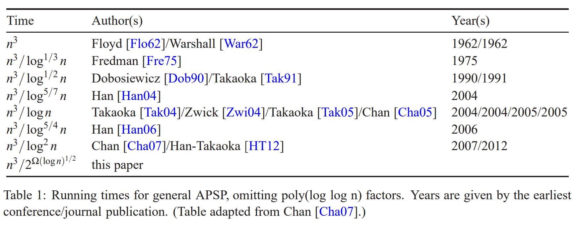
APSP: Current state of affairs
Williams: $O\left(\frac{n^{3}}{2^{\sqrt{\log{n}}}}\right)$ time

Slide 46
APSP: Current state of affairs
Williams: $O\left(\frac{n^{3}}{2^{\sqrt{\log{n}}}}\right)$ time
Idea: Use rectangular matrix mult
Current record: $n×n^{0.314}$ times $n^{0.314}×n$ matrix in $O(n^{2})$
Given
polynomial $p(a_{1},…a_{n},b_{1},…, b_{n})$ as $m^{0.15}$ monomials
set of $m$ monomials $A,B$
Can
Evaluate $p$ on all monomials in $A×B$
Using only $O(m^{2+o(1)})$ time
 | 1 | 2 | 3 | 4 | 5 | 6
1 | $$0$$ | $$x^{w(1,2)}$$ | $$x^{w(1,3)}$$ | $$0$$ | $$0$$ | $$0$$
2 | $$−x^{w(1,2)}$$ | $$0$$ | $$x^{w(2,3)}$$ | $$0$$ | $$0$$ | $$0$$
3 | $$−x^{ω(1,3)}$$ | $$−x^{ω(2,3)}$$ | $$0$$ | $$x^{w(3,4)}$$ | $$0$$ | $$x^{w(3,6)}$$
4 | $$0$$ | $$0$$ | $$−x^{w(3,4)}$$ | $$0$$ | $$x^{w(4,5)}$$ | $$x^{w(4,6)}$$
5 | $$0$$ | $$0$$ | $$0$$ | $$−x^{w(4,5)}$$ | $$0$$ | $$x^{w(5,6)}$$
6 | $$0$$ | $$0$$ | $$−x^{w(3,6)}$$ | $$−x^{w(4,6)}$$ | $$−x^{w(5,6)}$$ | $$0$$

Slide 47
NP-hard Problems In (moderately) exponential time

Slide 48
Computing Permanent (#PM’s)
Let $G=(L∪R,E)$ be a bipartite $L:=\{r_{1},…,r_{n}\}$, $R:=\{r_{1},…,r_{n}\}$
$$M\left[i,j\right]≔\left\{\begin{aligned}0, \text{if} \{l_{i},r_{j}\}∉E \\ &1, \text{if} \{l_{i},l_{j}\}∈E\end{aligned}\right.$$
$$\operatorname{per}\left(M\right)≔ \sum_{π:\left[n\right]↔[n]}{s\prod_{i}{M[i,j]} }$$
Can compute in $O(2^{n}n^{2})$ with Dynamic Programming:
For $i=0,…n$ and $X⊆R$:
$T\left[i,X\right]:=$per$(M[{\{l}_{1},…, l_{i}\},X])$
$T\left[0,X\right]=1$, if $X=∅$ and $0$ otherwise
$$T\left[i,X\right]=\sum_{j∈X}{T\left[i−1,X∖j\right]⋅M[i,j]}$$
Also: $2^{n}$ space

Slide 49
Inclusion Exclusion
Classical version: express the size of a union as size of an intersection: if $P_{1},P_{2}⊆U$
$\left|P_{1}∪P_{2}\right|=\left|P_{1}\right|+\left|P_{2}\right|−\left|P_{1}∩P_{2}\right|$
We are often interested in intersections:
$\left|P_{1}∩P_{2}\right|=\left|U\right|−\left|\overline{P_{1}}\right|−\left|\overline{P_{2}}\right|+\left|\overline{P_{1}∩P_{2}}\right|$
Generalizes to $n$ sets:
If $P_{1},…,P_{n}⊆U, \overline{P_{i}}=U∖P_{i},\bigcap_{i∈∅}{\overline{P_{i}}}=U$,

Slide 50
Ryser formula
Let $G=(L∪R,E)$ be a bipartite $L:=\{r_{1},…,r_{n}\}$, $R:=\{r_{1},…,r_{n}\}$
$$M\left[i,j\right]≔\left\{\begin{aligned}0, \text{if} \{l_{i},r_{j}\}∉E \\ &1, \text{if} \{l_{i},l_{j}\}∈E\end{aligned}\right.$$
$$\operatorname{per}\left(M\right)≔ \sum_{π:\left[n\right]↔[n]}{s\prod_{i}{M[i,j]} }$$
Quasi-matching: Set of edges s.t each $l_{i}$ is in exactly one edge
quasi-matching is PM iff it contains each $r_{i}$ in at least one edge
$U≔$all quasi-matchings of $G$
$P_{i}≔$all quasi-matchings of $G$ that contain $r_{i}$
L
R
1
1
2
2
$$\#PM^{′}s= \sum_{F⊆\{1,…,n\}}{{\left(−1\right)}^{|F|}}\prod_{i=1}^{n}{\sum_{j∈\{1,…,n\}∖F}{M[i,j]}}$$
3
3
4
4

Slide 51
Set Cover in $2^{n}n^{O(1)}$ time
Given sets $𝒮=\{S_{1},…,S_{m}\}⊆2^{[n]}$, integer $k$
Asked $X⊆[m]$ such that $\bigcup_{j∈X}{S_{j}}=[n]$
$$\left({a_{F} \atop k}\right)$$
$$U≔ \left({[m] \atop k}\right) P_{j}≔\{X∈U :j∈\bigcup_{i∈X}{S_{i}}\}$$
$a_{F}≔|\{i∈\left[m\right]:S_{i}∩F=∅\}|$, $s_{X}=1$ if $X∈ℱ$, otherwise
$$a={\left(\begin{matrix}1 & 1 \\ 1 & 0\end{matrix}\right)}^{⊗n}s$$
Gives $2^{n}m n^{O(1)}$ time. For $2^{n}n^{O(1)}$ use

Slide 52
Bonus Exercises
Find a clique on $6$ vertices in an $n$-vx graph in $n^{2ω}$ time
Counting Perfect Matchings in non-bipartite graphs Let $G$ be an $n$-vx graph compute $\#$PM’s of G in $2^{n}n^{O(1)}$ time
Finding Three Dimensional Matchings
Given: sets $A,B,C$ of size $n$ and $ℱ⊆A×B×C$
Asked: collection $S_{1},…,S_{n}∈ℱ$ such that each element of $A,B$ and $C$ is in some set.
Solve the problem in
$8^{n}n^{O(1)}$ time (Hint: Similar to 1.)
$4^{n}n^{O(1)}$ time (Hint: Define `Quasi-Matchings’)
$2^{n}n^{O(1)}$ time, probabilistically (Hint: `Quasi- matchings’ + PIT + determinant)

